Slide 1
MODULE 5 (strings)
Hemavathy S
Email: hemavathy.s@vit.ac.in
SENSE

Slide 3
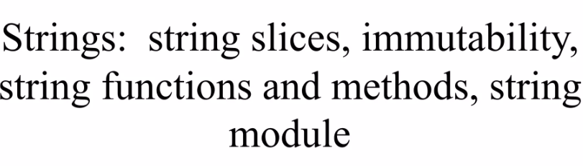

Slide 4
What is string?
String is a sequence of characters.
String may contain alphabets, numbers and special characters
Usually, strings are enclosed within single or double quotes
Strings are immutable in nature
Example:
a = ‘hello world’
b = “Python”

Slide 5
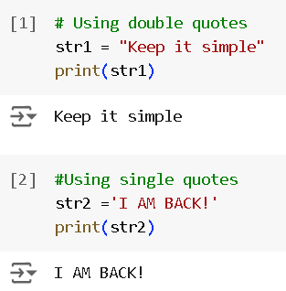
String creation

Slide 6
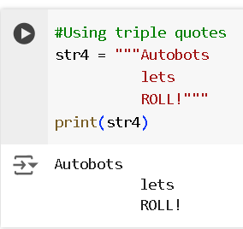
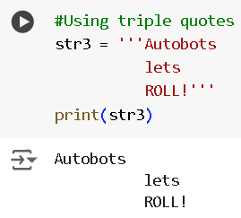

Slide 7
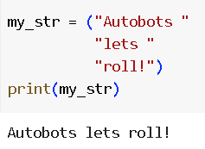
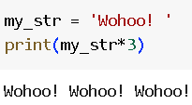

Slide 8
Inbuilt functions
len()
max()
min()
len() – Find out the length of characters in string.
min() – Smallest value in a string based on ASCII values.
max()- Largest value in a string based on ASCII values.

Slide 9
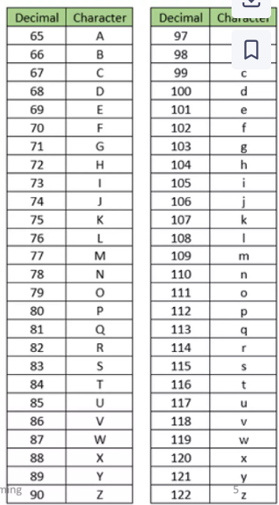
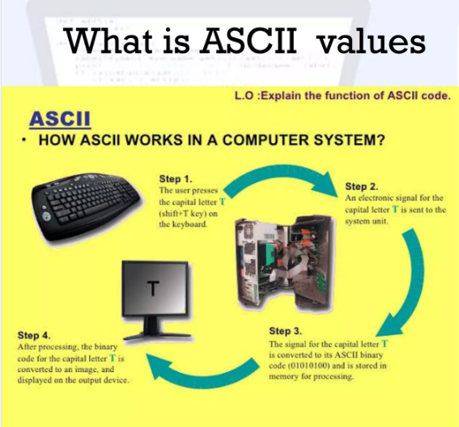

Slide 10
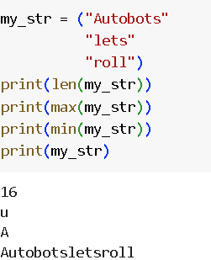

Slide 11
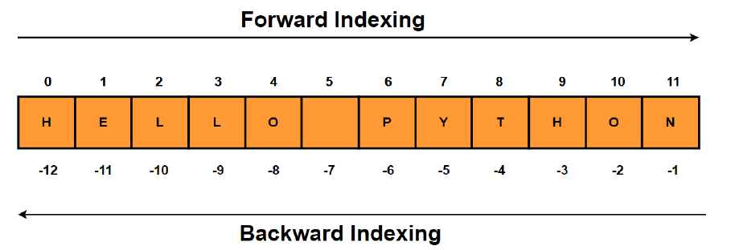
String indexing

Slide 12
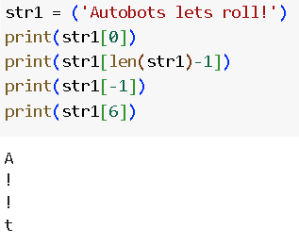
String indexing

Slide 13
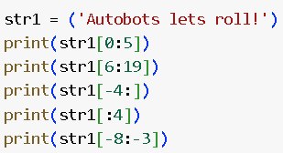
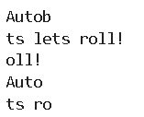
String slicing

Slide 14
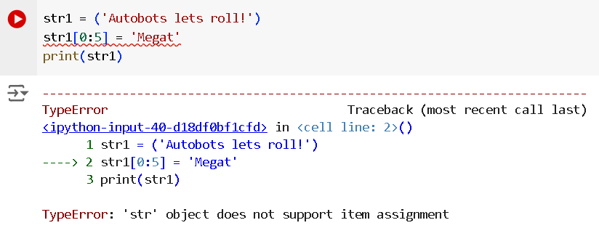
Update and delete string

Slide 15
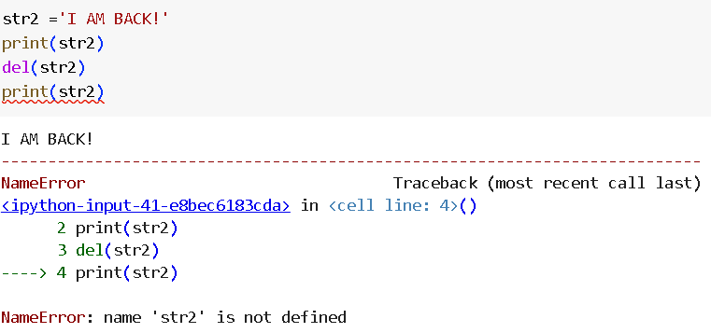

Slide 16
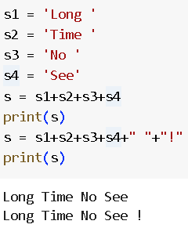
String concatenation

Slide 17
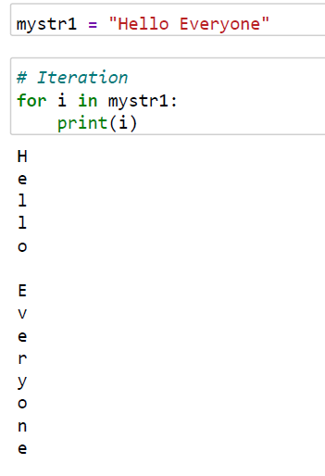
Iteration through a string

Slide 18
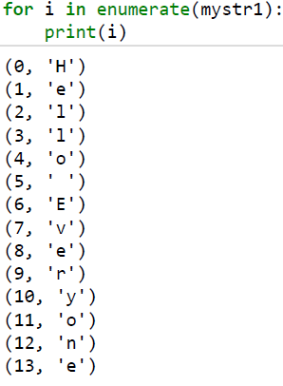

Slide 19
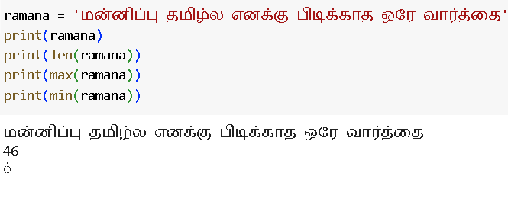

Slide 20
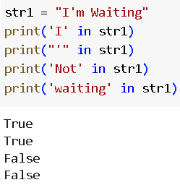
String Membership

Slide 21
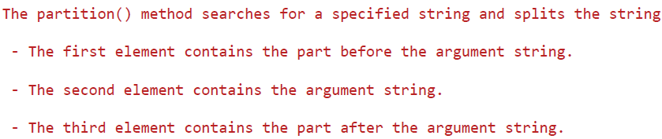
String partitioning

Slide 22
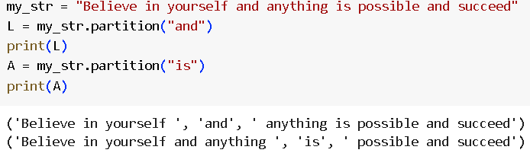

Slide 23
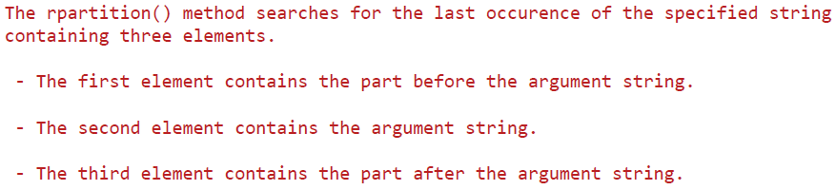
String rpartition

Slide 24
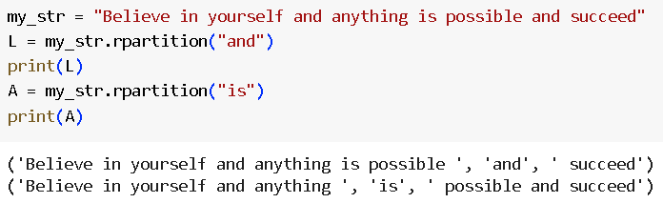

Slide 25
String functions
.strip()
.rstrip()
.lstrip()
.lower()
.upper()
.replace()
.count()
.split()
.startswith()
.endswith()
.format()
.center()
.rjust()
.find()
.rfind
.index()
.rindex()
.isalpha()
.isalnum()
.isdecimal()
.isnumeric()
.isupper()
.islower()

Slide 26
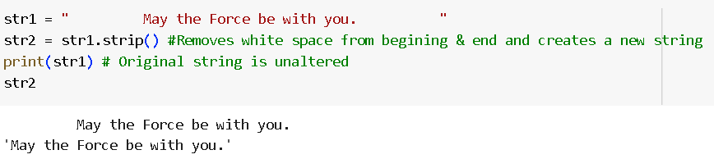
String functions
.strip()- Removes white space or any character given in the bracket from beginning & end and creates a new string

Slide 27
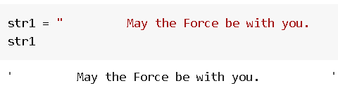
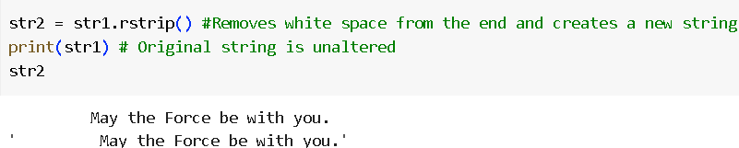
String functions
.rstrip()- Removes white space or any character given in the bracket from the end and creates a new string

Slide 28
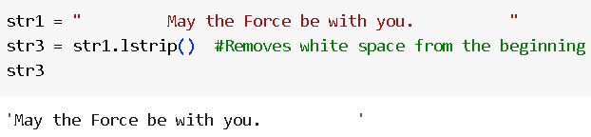
String functions
.lstrip()- Removes white space or any character given in the bracket from the beginning and creates a new string

Slide 29
String functions
.strip()

Slide 30
String functions
.strip()

Slide 31
String functions
.strip()

Slide 32
String functions
.strip()

Slide 33
String functions
.strip()

Slide 34
String functions
.strip()

Slide 35
String functions
.strip()

